Slide 1


Real-Time Assistance: Chatbot Solutions for Natural Calamities
Explore how AI-powered chatbots can provide critical aid to individuals and communities during natural emergencies.

Slide 2
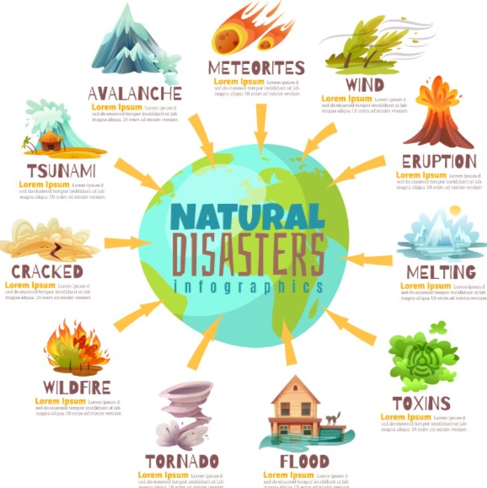
Understanding Natural Calamities and their Impacts
Natural disasters like hurricanes, earthquakes, and wildfires can devastate communities, destroy infrastructure, and disrupt essential services.
These events have far-reaching impacts on the environment, economy, and human wellbeing that can last for years.

Slide 3
Identifying Key Information Needs During Disasters
Situational Awareness
Emergency Resources
Safety Instructions
Communication Channels
Real-time updates on disaster location, severity, and affected areas
Accessible info on shelters, evacuation routes, and relief supplies
Tailored guidance on protective actions and staying safe
Connecting to loved ones and emergency responders

Slide 4
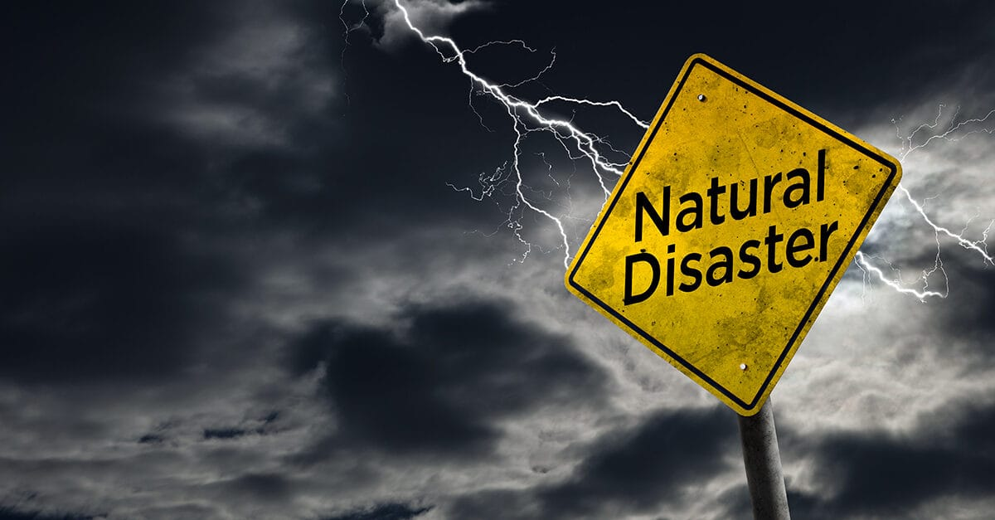
Designing the Chatbot's Knowledge Base
1
Identify Key Information Needs
Analyze common disaster scenarios and user queries to determine critical data points.
2
Curate Authoritative Content
Gather emergency preparedness guides, safety protocols, and response resources from reliable sources.
3
Structure the Knowledge Base
Organize information hierarchically for easy navigation and natural language processing.

Slide 5
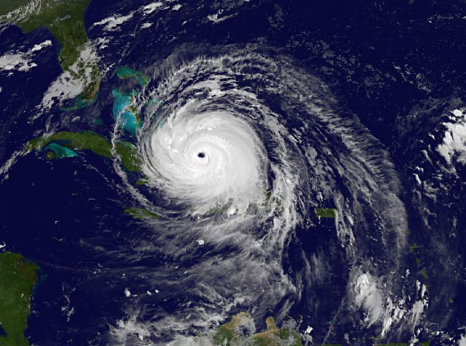
Integrating Real-Time Data Sources
Tap into live weather forecasts, emergency alerts, and evacuation route data to equip the chatbot with the latest disaster information.
Connect with government agencies, emergency services, and crowdsourced platforms to continuously update the chatbot's knowledge base.
Leverage IoT sensors and satellite imagery to monitor environmental conditions and detect emerging threats in real-time.

Slide 6




Enabling Multi-Channel Accessibility
Mobile App
Website
Hotline
Chatbot
Intuitive mobile app for on-the-go access
Responsive, easy-to-navigate website for desktop users
24/7 emergency hotline for voice assistance
Conversational AI for instant messaging support

Slide 7
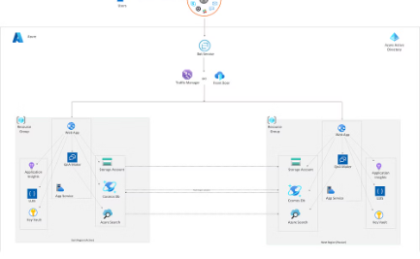

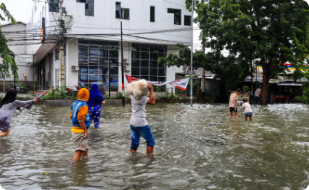
Providing Personalized Recommendations
Tailored to Your Location
Customized for Your Needs
Dynamic and Up-to-Date
Provides recommendations based on your address and local conditions.
Adapts its guidance to your unique situation and requirements.
Continuously updates its knowledge to reflect changing conditions.

Slide 8



Facilitating Emergency Coordination and Response
Rapid Information Sharing
1
Connecting community members and responders
2
Coordinated Resource Allocation
Efficiently distributing aid and supplies
Streamlined Rescue Operations
3
Guiding evacuations and first responder actions
The chatbot plays a crucial role in facilitating seamless emergency coordination and response efforts. By rapidly sharing real-time updates and alerts, the system enables community members and first responders to stay informed and aligned. Additionally, the chatbot coordinates the allocation of critical resources like shelter, food, and medical supplies to ensure they reach those in greatest need. Most importantly, the chatbot provides step-by-step guidance to streamline rescue operations, directing evacuations and guiding the actions of emergency personnel.

Slide 9
Ensuring Privacy and Security Measures
Secure Data Storage
Authenticated Access
Store user data safely using encryption and access controls.
Implement secure login and authorization mechanisms.
Transparent Data Policies
Ethical AI Principles
Clearly communicate how user information is collected and used.
Adhere to principles of privacy, fairness, and accountability.

Slide 10
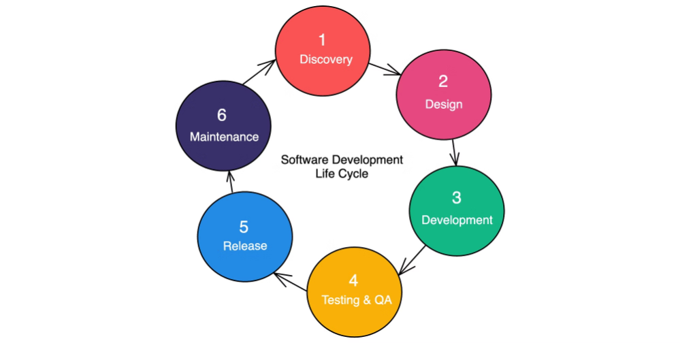
Evaluating Chatbot Performance and Iterating
Regularly assess chatbot's effectiveness through user feedback and analytics.
Identify areas for improvement and implement updates to enhance user experience.
Collaborate with domain experts to refine chatbot's knowledge base and responses.
Ensure privacy and security measures are working effectively.
Foster continuous improvement through iterative development and testing cycles.

